Slide 1
NJ Competitive Solar Incentive Program (“CSI”) Bidder Information Session
January 27, 2023 2:30 PM – 4:00 PM
Oomen, Veronique
Watson, Diane

Slide 2
Webinar Instruction Page
All attendees will be automatically muted
Questions? Please use the “Q &A” function in Zoom
We will address clarifying questions at the end of each section
Please note that the “Chat” function in Zoom is not available for this meeting, other than to broadcast the registered speakers “on deck”
This meeting is being recorded. A copy of the recording and slides will be made available on the BPU website: https://www.nj.gov/bpu/newsroom/public/

Slide 3
Disclaimer
This presentation is provided for informational purposes only and should not be taken to represent the views of the New Jersey Board of Public Utilities, its Commissioners, or the State of New Jersey. Please be aware that any information presented is subject to change if there are changes to New Jersey statutes, rules, or policies.
All viewers are responsible for ensuring that they rely only on current legal authority regarding the matters covered in the presentation.

Slide 4
Competitive Solar Incentive (CSI) Program Bidder Meeting
Jan 27, 2023

Slide 5
Agenda
Brief program overview
Project prequalification
Overview of prequalification
Siting
Other prequalification requirements
The prequalification process
The bid submission process

Slide 6
Brief Program Overview
Overview of the CSI Program & Key Dates
Purpose and Review of Tranches
Procurement Targets for Year 1
Pricing Structure

Slide 7
Competitive Solar Incentive (“CSI”) Program
What is the CSI Program?
Key Dates
Three-year program, part of the Successor Solar Incentive Initiative (“SuSI”)
Annual procurements for grid-supply solar, net-metered non-residential projects > 5MW and co-located storage projects
Projects not eligible for CSI may participate in the Administratively Determined Incentive (“ADI”) Program under SuSI
Solar PV target of 300 MW in Y1
Co-located storage target of 160 MWh in Y1
Projects split into 5 tranches based on characteristics and attributes
Competition within tranches on price alone
Jan 27 – Bidder Meeting
Feb 1 – Pre-qualification window opens and website go-live at noon
Mar 8 – Deadline for pre-qualification submission (optional)
Mar 24 – NJBPU to notify pre-qualification deficiencies for correction
Mar 31 – Deadline for final bid submission

Slide 8
Tranches of the CSI Program
Purpose of Tranches
Tranches
Separation of tranches allows like projects to compete on even footing where one single pool would disadvantage some projects with preferred attributes
Projects can compete in all tranches for which they qualify, but may only be awarded once
All projects are subject to siting requirements
Basic Grid Supply
Grid Supply on the Built Environment
Grid Supply on Contaminated Sites and Landfills
Net Metered Non-residential Projects above 5 MW
Storage Paired with Grid Supply Solar

Slide 9
Initial Procurement Targets – Year 1
Tranche Number | Tranche | Initial Procurement Target
1 | Basic Grid Supply | 140 MW
2 | Grid Supply on the Built Environment | 80 MW
3 | Grid Supply on Contaminated Sites and Landfills | 40 MW
4 | Net Metered Non-residential Projects above 5 MW | 40 MW
 | Total | 300 MW
5 | Storage | 160 MWh

Slide 10
Pricing Structure
Winning bidders are awarded fixed SREC-IIs
Bidders receive pay-as-bid pricing on fixed SREC-IIs
15-year qualifying life
Administrative awards, not contracts

Slide 11
End of Program Overview Section: Clarifying Questions?

Slide 12
Project Prequalification
Overview of Prequalification
Solar Siting Restrictions
Waiver Process
Other project prequalification elements

Slide 13
What is project prequalification?
Prequalification is a review to ensure that projects meet the requirements of the CSI Program and of the tranche into which they intend to bid.
For projects that meet prequalification requirements, final selection is based strictly on price within each tranche.

Slide 14
Do I have to prequalify my project(s)?
All projects must show that they meet the requirements for prequalification before their bid will be considered
However, bidders have the option to submit these materials for review prior to submitting a bid or after the prequalification review deadline

Slide 15
What is the benefit of meeting the prequalification application deadline?
Opportunity to correct: If you submit your pre-qualification by March 8, we will review it and let you know of any deficiencies by March 24, so you have the opportunity to correct these deficiencies before submitting your final bid.
After March 31, no further project revisions will be accepted, and projects that do not meet prequalification requirements will be disqualified.

Slide 16
Elements of Pre-qualification
Verification of compliance with siting criteria
Location outside prohibited areas
Location outside restricted areas or waiver
Compliance with caps on farmland, if applicable
Demonstration of tranche eligibility
Project size, project type, project location
Demonstration of project maturity
queue position or interconnection application with the EDC conditional approval
Notes:
I think that we need a slide like this, summarizing.

Slide 17
Prequalification requirements: Siting
Siting: Prohibited and Restricted Areas | Will petitions for waivers submitted to the Board be considered?
Land reserved under the Green Acres Program | Yes
Land located within the preservation area of the pinelands area | Yes
Land designated as forest area in the pinelands comprehensive management plan | Yes
Land designated as freshwater or coastal wetlands | Yes
Lands located within the Highlands preservation area | Yes
Forested lands | Yes
Prime agricultural soils and soils of Statewide importance | Yes, if it exceeds the 2.5% Statewide Threshold. A waiver is not needed for the first 2.5%. No, if it exceeds the 5% County Development Limit. A waiver is not needed for the first 5%.
Preserved farmland. | No

Slide 18
Siting Requirements – Statewide Threshold
2.5% Statewide Threshold
Solar development is allowed on the first 2.5% of Prime Agricultural Soils/Soils of Statewide Importance that are in Agricultural Development Areas (“ADAs”) statewide.
Exempt from general prohibition on siting on these lands.
Any development that exceeds the 2.5% Statewide Threshold would only be allowed if a waiver is obtained.
The table below illustrates the total number of acres allowed for solar development within the 2.5% Statewide Threshold.

Slide 19
Siting Requirements – County Development Limit
5% County Development Limit
Siting requirements include a strict 5% limit on the total amount of qualified farmland that is open to solar projects in any given county.
This means that a waiver cannot be obtained if the project would exceed the 5% County Development Limit.
The table on the following slide illustrates the acreage limits for solar development for each county in New Jersey.

Slide 20
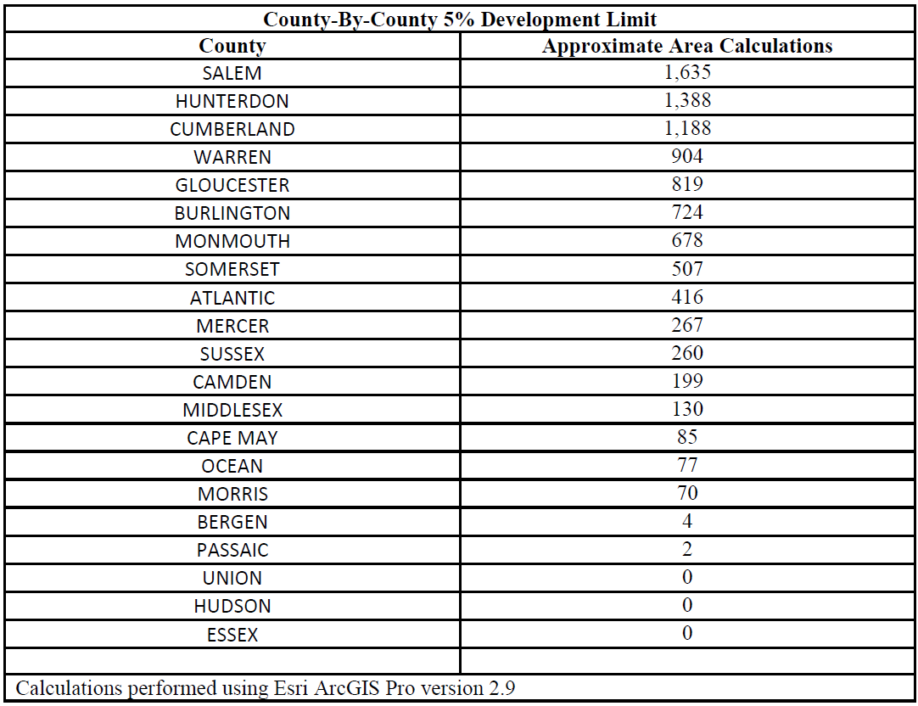
Siting Requirements – County Development Limit

Slide 21
Siting Requirements – Contaminated Sites & Landfills
Contaminated Sites & Landfills (Tranche 3)
“Contaminated site or landfill” is defined as any currently contaminated portion of a property on which industrial or commercial operations were conducted and a discharge occurred, and its associated disturbed areas.
Gravel, sand, and other historic mining sites where a discharge has occurred, and which currently constitute contaminated sites, are also covered under this definition.
In all instances, solar development on any properly closed landfill or contaminated site must be done in accordance with applicable DEP and local regulations and avoid interference with any remedial and/or closure activities or controls.

Slide 22
Siting Requirements – Waiver Process
Waiver Process, Tranches 1 and 3-5
Built Environment Administrative Waiver
The waiver process will apply to the development of solar facilities on any site with a prohibited designation, even when that site may simultaneously also have a non-prohibited Land Use / Land Cover designation(s).
The developer must submit to the Board a petition that “set(s) out the unique factors that make the project consistent with the character of the specific parcel” and gives examples.
The Board and its sister agencies will consider any mitigation measures project proponents suggested in determining whether a particular solar project is in the public interest.
Example: donating substantial desirable land into permanent conservation
The Board will consider waiver requests in consultation with the DEP or Secretary of Agriculture, as appropriate.
Waiver requests will be rejected if it would exceed the 5% County Development Limit.
Projects proposed on the Built Environment are eligible for an administrative waiver that can be granted by Board Staff.
Applicants for an administrative waiver must submit a request to the Board Secretary.

Slide 23
Other Project prequalification elements
Tranche eligibility
Project maturity
Project size
Project type
Project location
Demonstration of project maturity
PJM queue position OR evidence of approved distribution utility interconnection
As applicable
Public entity
Paired storage
Evidence of permits or applications

Slide 24
End of Prequalification Section: Clarifying Questions?

Slide 25
Prequalification Process
Timeline & Process
Website Info & Accessing the Prequalification Form
Qualification Form Preview
Questions

Slide 26
Pre-qualification and Bid Submission Timeline
Note: Bidders may submit new bids and prequalification information until the final deadline; however, only bidders who submit prequalification information by March 8, 2023, will be guaranteed that their applications will be reviewed for deficiencies and that they will be given the opportunity to cure these deficiencies prior to the final bid deadline. After the final bid deadline, no changes to bids or prequalification information will be accepted.
Event | Date
Pre-qualification window opens | February 1, 2023, 12:00 pm
Pre-qualification deficiencies will be reported back to bidders by this date for correction | March 24, 2023
Deadline for final bid submission | March 31, 2023, 11:59:59 pm

Slide 27
Application Process
Pre-Qualification Application Submission
After each pre-qualification form is submitted, an auto-generated “Project ID” will be provided on the submission page, as well as emailed to the developer
Deficiency review process
For pre-qualification applications submitted prior to March 8th, 2023, applications will be reviewed for deficiencies and will be given the opportunity to cure these deficiencies prior to the final bid deadline
Bid Submission

Slide 28
Accessing the Pre-Qualification Application
To access the application, please go to NJCSISOLAR.COM
Page will be live at noon, February 1.
Submit Qualification Application

Slide 29
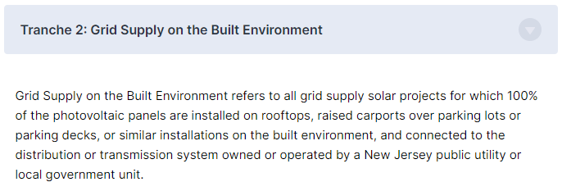
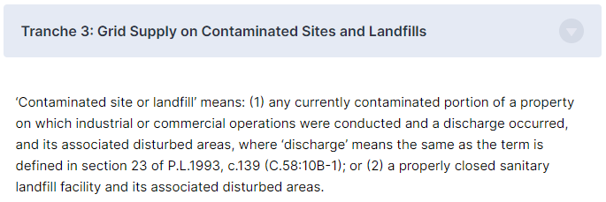
Qualification Form – Tranche Selection
Depending upon the tranche of the project, a few additional fields may appear

Slide 30
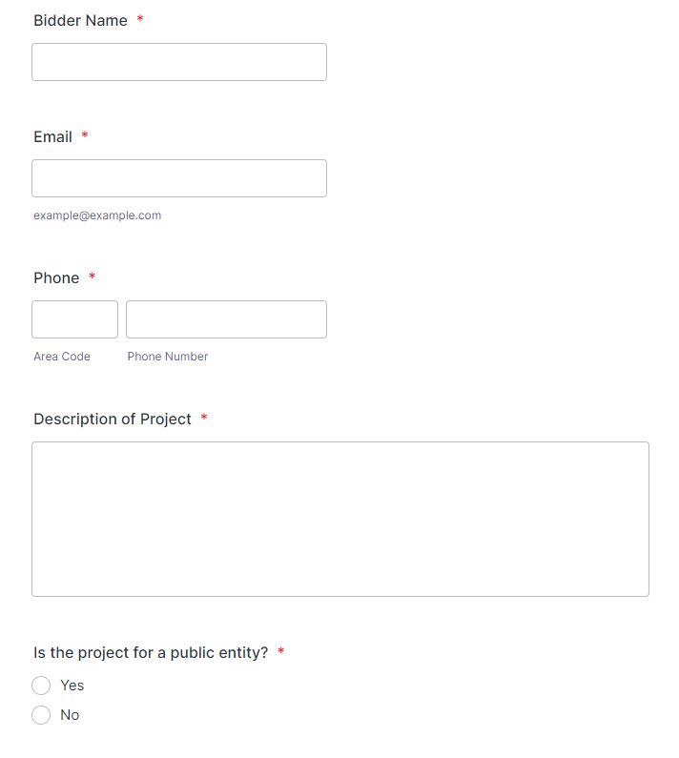
Qualification Form – General Information
Description of project:
Please describe the project site, including size, location, technologies involved, and the developing entity’s name
Public entity projects:
Please select “Yes” if you are a public entity developing the project or have a firm offtake agreement with a public entity.

Slide 31
Qualification Form – Project Location
Shapefile:
Please upload a shapefile of your project
Site plan:
Please upload a site plan showing the location of your project within the plot of land, including any special land designations to meet siting requirements.

Slide 32
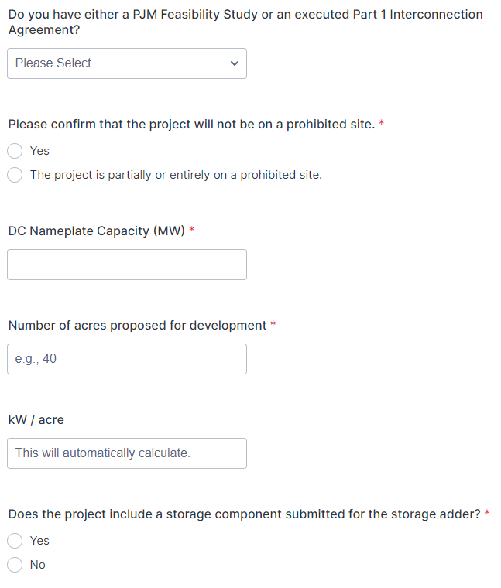
Qualification Form – Feasibility and Land-Use
Feasibility study:
Please upload the project’s completed Feasibility Study link as conducted by PJM’s interconnection process OR evidence of approved distribution utility interconnection
Compliance with siting restrictions:
Bidders must affirm that their project will not be constructed on a prohibited site (no waivers possible for projects located on preserved farmland or covered farmland in excess of the county concentration limit).
Land use waivers:
When a project is on restricted or otherwise prohibited land types, your project may require a waiver to participate in the CSI program. (See “Siting” section of the Board Order). Please upload any currently held waivers here.

Slide 33
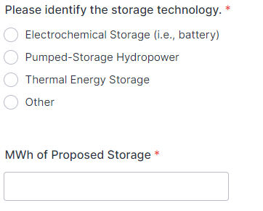
Qualification Form – Storage Component
To include a storage component submitted to the storage adder, please select “yes” for the first question. An additional section will appear for you to include your storage information.
A situation may arise where the solar component may receive an award where the storage component does not. In this field, please indicate if you would accept an award as a stand-alone solar facility.

Slide 34
Qualification Form – Tranche-3 Special Fields
Tranche 3 projects must submit their completed DEP Permit Readiness Checklist.

Slide 35
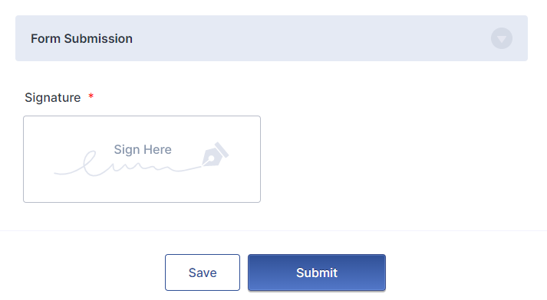
Qualification Form -- Signature
Please digitally sign the form and submit.
There is also an option to save and resume the form later.

Slide 36
End of Prequalification Section: Clarifying Questions?

Slide 37
Bid Submission Process
Bid Participation Fee
Accessing the Bid Form
Bid Form Preview
Questions

Slide 38
Bid participation fee
Bid fee
How to submit
Non-refundable Bid fee of $1,000/MW
Public entities exempt from bid fees
Make out checks to “Treasury, State of New Jersey”
Download and complete the “Bid Fee Form” from the NJCSI site.
Scan or take a picture of the check
Send the form and the check to:
CSI Program Solicitation
Attn: Curtis Elvin, Budget & Fiscal Division
New Jersey Board of Public Utilities
44 South Clinton Avenue
P.O. Box 350
Trenton, NJ 0825-0350

Slide 39
Accessing the Bid Form
Bid Forms can be completed at any time after the Qualification Application is submitted and a Project ID is generated, up to the March 31 deadline
To access the bid application, please go to NJCSISOLAR.COM
Submit Bid Application

Slide 40
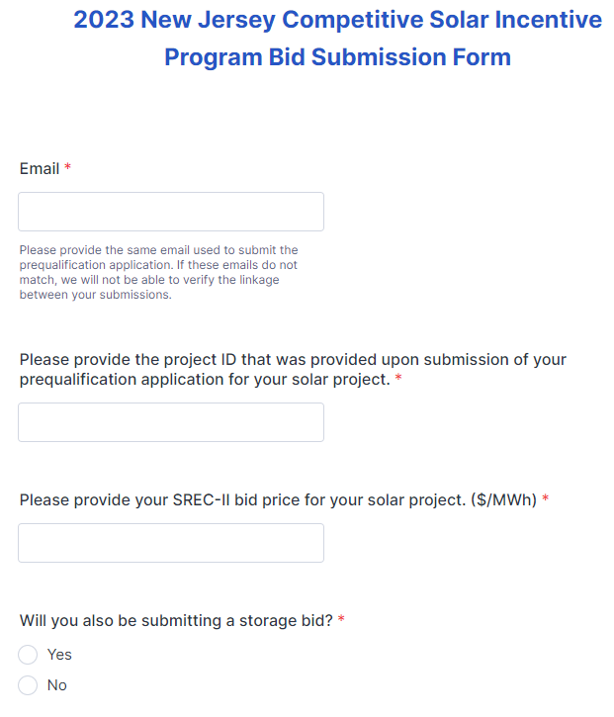
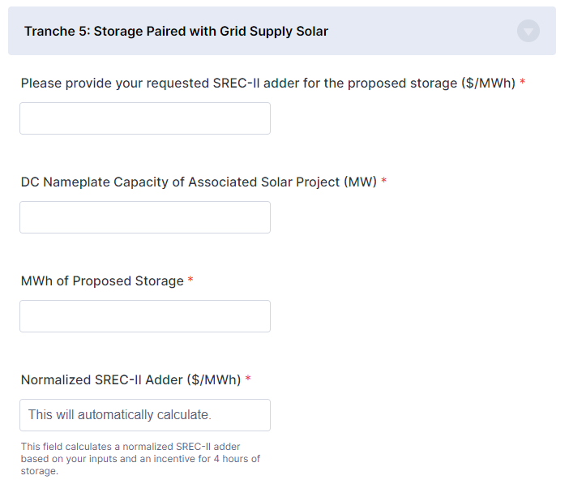
Bid Submission Form
Note: the normalized SREC-II adder is what will be used to evaluate your bid.

Slide 41
Bid Submission Form – Storage Adder Examples
Auto-calculated
Auto-calculated

Slide 42
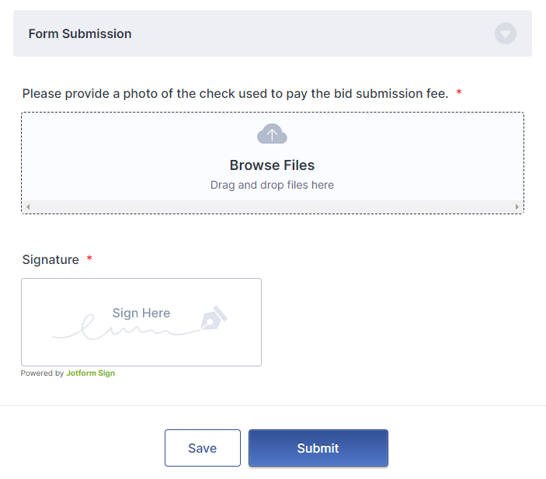
Bid Submission Form - Submission

Slide 43
End of Bid Form Section: Clarifying Questions?

Slide 44
Questions during the pre-qualification and bid submission process
Please direct any program-related questions to the NJBPU Staff:
Diane.Watson@bpu.nj.gov
Please direct any technical issues with the application or the website to Daymark Energy Advisors:
NJCSI@daymarkea.com
Answers to all questions will be posted on the FAQ tab at NJCSISOLAR.COM. Please check this page for updates and clarifications.

Slide 45
Questions?

